Slide 1
Number System

Slide 2
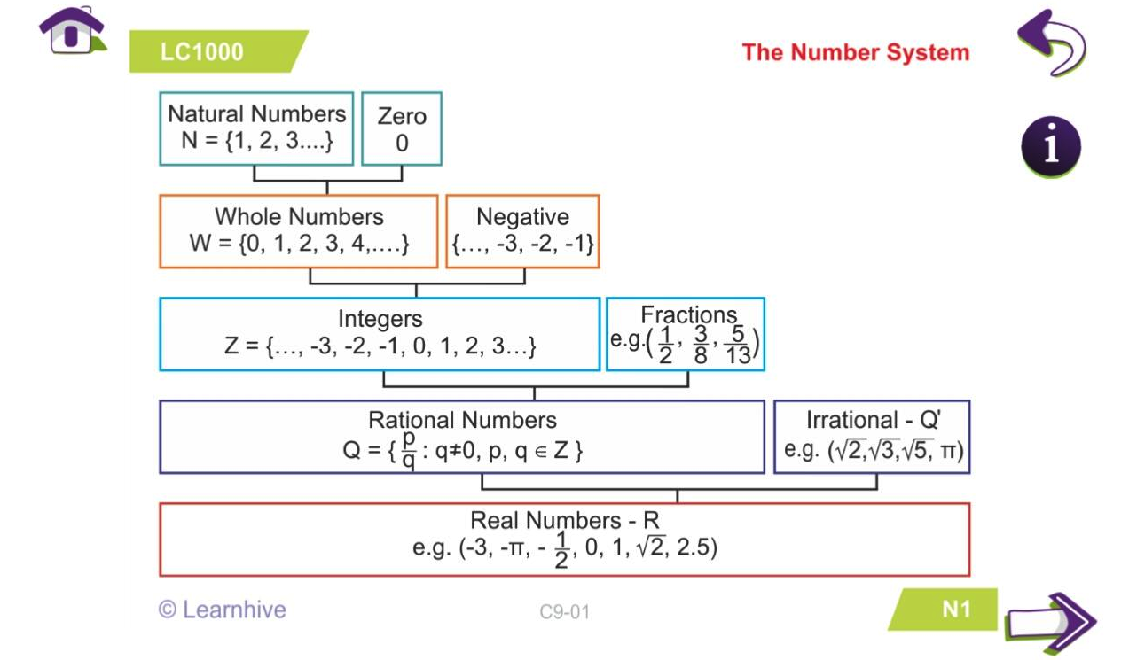
Divi

Slide 3
Prime Numbers:
51 - 60
61 -70
81 - 90
91 - 100
1-10
21-30
31-40
41-50
71 - 80
11-20
D D
B B C
B B C
B A
4
4
2
2
3
2
2
3
2
1
TwinPrime
Co-Prime
Composite Numbers :

Slide 4
2 | Unit digit of the number should be even number or zero(0,2,4,6,8)
3 | Sum of the digits of the number should be divisible by 3.
4 | Last two digits of the number should be divisible by 4.
5 | Last digit of the number should be Zero or 5.
6 | The number should be divisible by 2 & 3 .
7 | Double of the unit digit of the number subtract from rest of the digits of the number, the result should be either multiple of 7 or zero. Ex: 133, 3402,
8 | Last three digits of the number should be divisible by 8.
9 | Sum of the digits of the number should be divisible by 9.
11 | The difference between sum of odd place digits and sum of even place digits should be either multiple of 11 or zero.
12 | The number should be divisible by 4 & 3 .
13 | The sum of four times of unit digit and rest of digits should be multiple of 13. Ex: 624,

Slide 5
Sum of first n natural numbers = n*(n+1)/2
Average of first n natural numbers = (n+1)/2
Sum of squares of first n natural numbers = n*(n+1)*(2n+1)/6
Avg of squares of first n natural numbers = (n+1)*(2n+1)/6
Sum of cubes of first n natural numbers = n²(n+1)²/4
Avg of cubes of first n natural numbers = n(n+1)²/4
Sum of first n even numbers = n*(n+1)
Avg of first n even numbers = n+1
Sum of first n odd numbers = n²
Avg of first n odd numbers = n

Slide 7
Unit Digit & No.of zero’s for the following Questions
56 * 89 * 78 * 46 * 84 * 26 * 73 * 94 * 79
79*77*93*17 * 19 * 23 * 27 * 15 * 37 * 57
45 * 64 * 53 * 15 * 24 * 32 * 39 * 54 * 85
25 * 16* 89 * 78 * 64 * 56 * 125 * 50

Slide 8
Unit Digit & No.of zero’s for the following Questions
56 * 85 * 75 * 48 * 83 * 25 * 64 * 76 * 172
18*25*95*15 * 19 * 22 * 25 * 15* 35 * 59
29 * 65 * 55 * 38* 24 * 36 * 39 * 25 * 73
125 * 164* 225 * 75 * 64 * 96 * 12 * 58

Slide 9
Find the no.of zero’s at the end of 100! ?
Find the no.of zero’s at the end of 129! ?
Find the no.of zero’s at the end of 274! ?
Find the no.of zero’s at the end of 1000! ?

Slide 10
When 113! is divided by 5^{n} the result an integer. Find the highest possible value for n?
When 134! is divided by 2^{n} the result an integer. Find the highest possible value for n?
When 157! is divided by 3^{n} the result an integer. Find the highest possible value for n?
When 256! is divided by 7^{n} the result an integer. Find the highest possible value for n?
When 87! is divided by 3^{n} the result an integer. Find the highest possible value for n?
When 99! is divided by 2^{n} the result an integer. Find the highest possible value for n?

Slide 11
Find the Unit Digit in following each case
If unit digit of base value is 0,1,5 & 6 then the unit digit of the number will be same as 0, 1, 5 & 6 Resp.
2¹---2
2²----4
2³----8
2⁴----16
2⁵----32
2⁶----64
4¹---> 4
(278)¹⁹⁸
9¹---> 9
4²--- 6
9²--- 1
4³--- 4
9³--- 9
4⁴--- 6
9⁴---1
4⁵--- 4
9⁵--- 9
4⁶--- 6
9⁶--- 1
If unit digit of base value is 2,3 ,7 & 8
Power value Divide with 4 then possible remainders are 0,1,2,3 Resp.
Unit digit of Number = (unit digit of base value)^{Remainder}

Slide 12
(257)²⁵⁹
=> (7)^{59/4(R=3)} = 7³= 343 So unit digit is 3 .
(373)⁹⁵⁵
=> (3)^{55/4(R=3)} =3³= 27 So unit digit is 7 .
(978)⁹⁷⁸
=> (8)^{78/4(R=2)} =8²= 64 So unit digit is 4 .
(692)⁵⁶³⁷
=> (2)^{37/4(R=1)} =2¹= 2
So unit digit is 2 .
Note: Whenever Remainder = 0, then we will consider that as 4 because that power value is exactly a multiple of 4.

Slide 13
Note: Whenever Remainder = 0, then we will consider that as 4 because that power value is exactly a multiple of 4.
(257)²⁸⁴
=> (7)^{84/4(R=0)} = 7⁴= 2401 So unit digit is 1 .
(373)⁹⁵²
=> (3)^{52/4(R=0)} =3⁴= 81 So unit digit is 1 .
(978)⁹⁷⁶
=> (8)^{76/4(R=0)} =8⁴=4096 So unit digit is 6 .
(692)⁵⁶³⁹²
=> (2)^{92/4(R=0)} =2⁴= 16
So unit digit is 6 .

Slide 14
(393)⁷⁴³⁸
12358¹²⁹
36541⁶⁵⁸
(254)⁶⁹⁸
589⁴⁷⁵
125⁴⁵³
2356⁴⁵⁸
(369)⁶⁷²⁵
897¹²⁶
1458³⁶⁵⁴
The unit digit of the following expression is
(1!)¹ + (2!)² + (3!)³ + (4!)⁴ + (5!)⁵ + (6!)⁶

Slide 15
(393)⁷⁴³⁸
12358¹²⁹
36541⁶⁵⁸
(368)¹²³⁶
159⁷⁸⁹⁴
123⁷⁸⁵ * 512²¹⁵
3785⁴⁴⁹
192¹²⁶*152³²⁵
1458⁵⁴+542²¹⁴
237²⁴⁸ - 223²⁵⁸
The unit digit of the following expression is
(1!)¹ * (2!)² * (3!)³ * (4!)⁴ * (6!)⁶

Slide 16
Factors:
Find the no.of factors = (x+1)(y+1)(z+1)
Find the no.of factors except ‘1’ and itself = no.of factors -2
Find the no.of pair of factors = no.of factors(n=even)/2
Find the no.of pair of factors = no.of factors+1(n=odd)/2
Find the no.of pair of different factors = n/2(n=even)
Find the no.of pair of different factors= n-1/2(n=odd)
Find the no.of prime factors = x+y+z
Find the no.of different prime factors = no of base values

Slide 17
Factors:

Slide 18
Remainder Theorem :-
14 * 15
37 * 43 * 51
62 * 63 * 64
8
7
66

Slide 19
Remainder Theorem :-
(37)¹²⁹⁷
41²⁸⁷⁸
43¹⁹⁷
(25)¹⁰⁰
(9)⁵⁰
7
7
9
7
7
(9)⁸⁸
(8)⁹⁹
(9)¹⁰⁰
(3)²⁵⁰
8
7
7
7

Slide 20

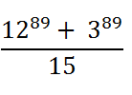






Remainder Theorem :-

Slide 21
Find the reminder when 1! + 2! + 3! + . . . . .. . .. 99! + 100! is divided by the product of first 7 natural numbers
The numbers 1 to 29 are written side by side as follows
1234567891011............................ 28 29 If the number is divided by 9, then what is the remainder?
(a) 3 (b) 1 (c) 0 (d) None of these
The numbers 1 to 40 are written side by side as follows
1234567891011............................ 3940 If the number is divided by 8, then what is the remainder?
(a) 3 (b) 4 (c) 0 (d) None of these

Slide 22
A Certain number when divided by 95 leaves a remainder 30. What is the remainder if, the same number be divided by 19?
(1) 8 (2) 9 (3) 10 (4) none these (11)
A number when divided by 5 leaves a remainder 3. What is the remainder when the square of the same number is divided by 5 ? a) 9 (b) 3 (c) 0 (d) 4
A number when divided by 342 gives a remainder 47. When the same number if divided by 19, what would be the remainder ?
A number A4571203B is divisible by 18. Find the value of A and B.
(a) 8, 4 (b) 6, 8 (c) 4, 6 (d) 6, 6

Slide 23
A number being successively divided by 3, 5 and 8 leaves remainders 1, 4 and 7 respectively. Find the respective remainders if the order of divisors be reversed,

Slide 24
LCM & HCF

Slide 25
Find LCM & HCF for 144,180,192?
H. C. F. of 2³, 3² and 15 is— (A) 23(B) 32(C) 1 (D) 360
H. C. F. of 42, 63 and 140 is—(A) 14 (B) 9 (C) 21 (D) 7
What is the least number by which 2800 should be multiplied so that the product may be a perfect square ?

Slide 26
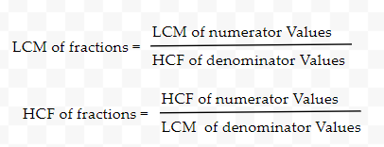
FRACTIONs:
Find LCM & HCF for ⅔,¾,⅘,⅚.
Find LCM for 5/2, 8/9, 11/14

Slide 27
Note: Product of two numbers = LCM of two numbers * HCF of two numbers
LCM of two numbers is 11781 and HCF of two numbers 119.
If one of the number is 1071 then find the other number?
The H. C. F. of two numbers is 4 and their L. C. M. is 576. If one of the numbers is 64, find the other number.

Slide 28
Note:
The greatest number which exactly divides x, y, z :
HCF of (x,y,z)
2. The least number which exactly divided by / divisible by x, y,z :
LCM of (x,y,z)
Find the largest number which can exactly divide 96,528,792
Find the least number which can exactly divisible by 32,40,48.

Slide 29
Divide Condition :
Largest number which divides x,y,z to leaves remainder R (i.e. same) = h.c.f of x-R, y-R, z-R.
Largest number which divides x,y,z to leaves remainders as a,b,c = h.c.f. of ( x-a, y-b, z-c.)
Largest number which divides x,y,z to leave same remainder = h.c.f. of (|y-x|, |z-y|, |z-x|.)

Slide 30
Divisible By Condition :
Least number which when divided by x,y,z = ( l.c.m. of x,y,z)
Least number which when divided by x,y,z and leaves a remainder R in each case = ( l.c.m. of x,y,z) + R
Least number which when divided by x,y,z and leaves a remainder a, b, c Resp.= ( l.c.m. of x,y,z) - K.
K=X-a= Y-b=Z-c

Slide 31
Find the largest number which can divide 728, 900 and leaving remainders as 8 and 4 respectively.?
Find the largest number which can divide 410,751,1030 and leaving remainder as 7 in each case?
Find the 4-digit greatest number which can exactly divisible by 24,30,36

Slide 32
What i sthe greatest number that will divide 8162 and 9123 and leave remainders 2 and 3 respectively.
34
46
48
36

Slide 33
What is the least number of square tiles of the uniform size required to pave the floor of a rectangular hall of length 20 m and breadth 16 m?
1) 15 2) 20 3) 35 4) 8 5) None of these
Three drums contains 36 litres, 45 litres and 72 litres of oil. What biggest measure can measure
all the different quantities exactly ?

Slide 34
Three persons A, B, C run along a circular path 12 km long. They start their race from the same point and at the same time with aspeed of 3 km/hr,7 km/hr, and 13 km/hr. respectively.After what time will they meet again ?
(A) 12 hrs (B) 9 hrs
(C) 24 hrs (D) 16 hrs

Slide 35
In an examination, a student scores 4 marks for every correct answer and loses 1 mark for every wrong answer. A student attempted all the 200 questions and scored. In all 200 marks. The number of questions, he answered correctly was

Slide 36
The sum and product of two numbers are 11
and 18 respectively. The sum of their reciprocals is ?

Slide 37
Averages

Slide 38
Averages:
The average of 8 number is 21.If each of the numbers is multiplied by 8, the average of the
new set of numbers is :

Slide 39
Averages:
The average weight of A, B, C is 45 kg. If the average weight of A and B be 40 kg and that of B and C be 43 kg, then the weight of B is :

Slide 40
Averages: Combined Group Average
The average salary of all the workers in a workshop is Rs.8000. The average salary of 7 technicians is Rs.12000 and the average salary of the rest is Rs.6000. The total number of workers in the workshop is ?

Slide 41
Averages: Combined Group Average
A family consists of two grandparents, two parents and three grandchildren. The average age of the grandparents is 67 years, that of the parents is 35 years and that of the grandchildren is 8 years. What is the average age of the family?

Slide 42
Averages: Combined Group Avg
9 people went to a hotel for combined dinner. 8 people out of 9 spend Rs. 30 each on dinner . 9th person spend Rs. 20 more than then average of all 9 persons. Find the total expenditure on dinner.

Slide 43
Averages: Combined Group Avg
In an exam, the average marks for 80 students of Class V is 35. The average of marks in section A of the class is 55 while the average of marks in section B is 30. Find the number of students in Class V B.
a. 45
b. 50
c. 64
d. 70

Slide 44
Averages: Include/exclude case
The average age of 12 students in a group is 14 years. When teacher's age is included to it, the average increases by 2. What is the teacher's age in years ?
The average age of 4 brothers and their father in a family is 11 years. When father's age is excluded, the average decreases by 5. What is the father's age in years ?

Slide 45
Averages: Include/exclude case
The average age of 18 students in a group is 15 years. When two teacher's age is included to it, the average increases by 3. What is the average age of teacher’s in years ?
In an examination 15 students average marks noted as 240. Whenever 5 students marks excluded then average decreases to 200. Then find the average marks of those excluded students ?

Slide 46
Averages: Replacement case
New person value - Removed person value = no.of person’s * change in Average
The average weight of 8 persons increases by 1.5 kg. If a person weighing 65 kg is replaced by a new person, what could be the weight of the new person?

Slide 47
Averages: Replacement case
In a class, there are 20 boys whose average age is decreased by 2 months, when one boy aged 18 years is replaced by a new boy. Find the age of new boy.
The average age of 8 persons in a committee is increased by 2 years when two men aged 35 years and 45 years are substituted by two women. Find the average age of these two women.

Slide 48
Averages:
A mathematics teacher tabulated the marks secured by 35 students of 8th class. The average of their marks was 72. If the marks secured by Reema was written as 36 instead of 86 then find the correct average marks upto two decimal places.
(a) 73.41
(b) 74.31
(c) 72.43
(d) 73.43
(e) Cannot be determined

Slide 49
Averages:
The average of 10 numbers is 40.2. Later it is found that two numbers have been wrongly copied. The first is 18 greater than the actual number and the second number added is 13 instead of 31. Find the correct average.?
(a) 40.2
(b) 40.4
(c) 40.6
(d) 40.8
(e) None of the above

Slide 50
Averages:
Three years ago, the average age of a family of 5 members was 17 years. A baby having been born the average age of the family is the same as three years ago. The present age of the baby (in years) is:
The average age of 40 students in a class is 15 years. When 10 new students are admitted, the average is increased by 0.2 year. Find the average age of the new students. ?

Slide 51
Averages:
10 years ago, the average age of a family of 4 members was 24 years. Two children having been born (with age difference of 2 years), the present average age of the family is the same. The present age of the youngest child is :

Slide 52
Averages:
The average temperature of the town in the first four days of a month was 58 degrees. The average for the second, third, fourth and fifth days was 60 degrees. If the temperatures of the first and fifth days were in the ratio 7 : 8, then what is the temperature on the fifth day ?
A) 62 degrees
B) 64 degrees
C) 65 degrees
D) 66 degrees

